Slide 1
Min- Max Algorithm
It can be used for games having 2 players.
Eg:- Chess, tic-tac-toe, etc. (Logic Games).
Algorithm is effective for games which have few logical possible state transitions from the current sate.
There are two views- MAX view and MIN view.
Nodes that belong to MAX are given the maximum value of its children.
Nodes that belong to MIN are given the minimum value of its children.
In short, MAX tries to move to the state of maximum value and MIN tries to move to the state of minimum value.

Slide 2
An optimal procedure: The Min-Max method
Designed to find the optimal strategy for Max and find best move:
1. Generate the whole game tree, down to the leaves.
2. Apply utility (payoff) function to each leaf.
3. Back-up values from leaves through branch nodes:
a Max node computes the Max of its child values
a Min node computes the Min of its child values
4. At root: choose the move leading to the child of highest value.

Slide 3
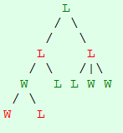
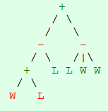
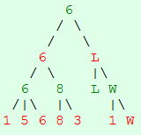
Example(1)
Consider + as MAX(player 1) and – as MIN(player 2) . Max will always select maximum value of its children whereas MIN will select minimum value of its children.

Slide 4
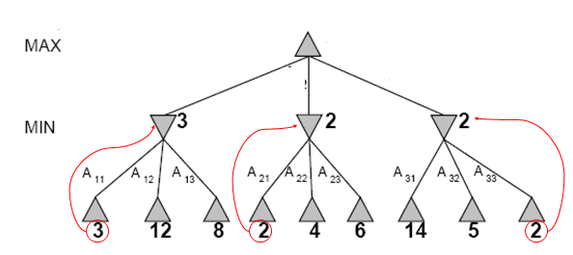
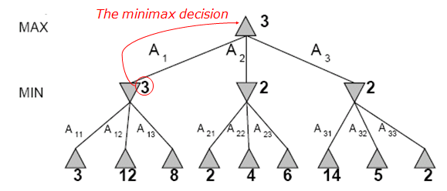
Example(2)

Slide 5
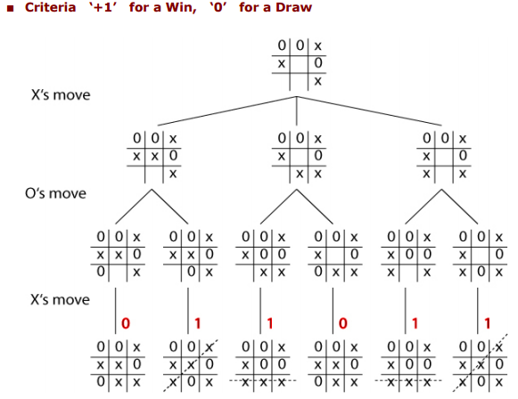
Example (3): Evaluation of the Tic-tac-toe problem.

Slide 6
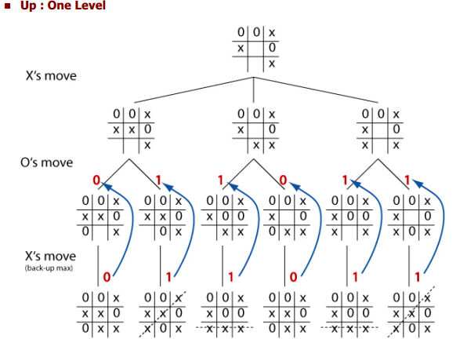

Slide 7
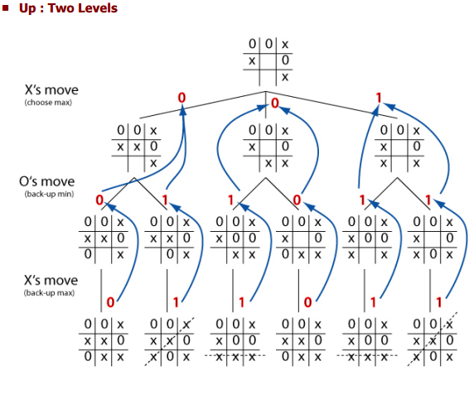

Slide 8
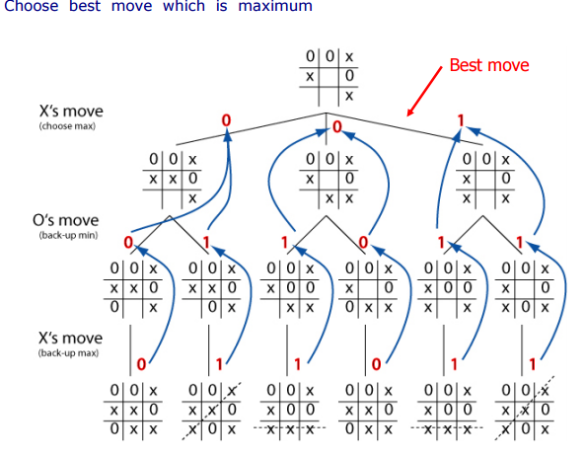

Slide 9
Properties Of Min- Max Algorithm
Complete – Yes.
Optimal – Yes.
Time Complexity – O(b^m).
Space Complexity – O(bm)
Note :- Inefficient for games with huge search space since it will take longer time to compute.

